Slide 1
CRANIOSYNOSTOSIS

Slide 2
Pathological condition that results from premature fusion of one or more sutures in the cranial vault;
Associated with a deformity of the vault and cranial base.

Slide 3
Development
Bones of the cranium
The skull base and the calvarial vault
Growth of skull bones
Expanding growth of the brain.

Slide 4
Brain Growth
At term has
nearly 40 percent of his or her adult brain volume,
And this increases to 80 percent by three
years of age.
Continues to grow until the age of 12 yrs

Slide 5
The cranium
At term is 40 percent of adult size;
By seven years, this increases to 90 percent.
Sun PP, Persing JA. Craniosynostosis. In: Albright
AL, Pollack IF, Adelson PD, eds. Principles and practice
of pediatric neurosurgery. New York: Thieme Medical, 1999:219-42.

Slide 6
Timing of Closure of Sutures
and Fontanelles
Type of suture/fontanelle Time to closure
Metopic suture Nine months to two
years (may persist
into adulthood)
Coronal, sagittal, 40 years
lambdoid sutures
Anterior fontanelle Nine to 18 months
Posterior fontanelle Three to six months
Anterolateral fontanelle Three months
Posterolateral fontanelle Two years
Adapted with permission from Aviv Ri, Rodger E Hall CM. Craniosynostosis. Clin Radiol 2002;57:94.
Mature suture closure occurs by 12 years of age, but completion continues into the third decade of life and beyond.

Slide 7
HISTORY AND PATHOGENESIS
Otto ( 1830) coined the term craniosynostosis
Stahl and Hyrtl noticed that premature closure of the cranial vault sutures leads to an abnormal skull shape.
In 1851, Virchow described how skull growth is restricted to a plane perpendicular to the affected, prematurely fused suture and is enhanced in a plane parallel to it.

Slide 8
Suture Growth
Sutures allow growth perpendicular to them
  Growth at suture lines related to brain growth

Slide 9
Virchow - classify the different types of skull
deformity
Van der Klaauw, in 1946, and Moss, in 1959.
Cranial base source of abnormal physical stress leading to dural abnormalities that yielded premature sutural fusion

Slide 10
Animal studies
The cranial vault abnormalities typical of synostosis can be produced with experimental fusion of developing cranial vault sutures.
1. Persing JA, Babler WJ, Jane JA, et al. Experimental unilateral coronal synostosis in rabbits. Plast Reconstr Surg. 1986;77:369–376.

Slide 11
Marsh and Vannier –
Following cranioplasty in patients with individual suture craniosynostosis in which surgery altered only the cranial vault structure, previously developed cranial base abnormalities were ameliorated
Marsh JL, Vannier MW. Cranial base changes following surgical treatment
of craniosynostosis. Cleft Palate J. 1986;23(suppl. 1):9.

Slide 12
L.C Lane First surgical procedure to release stenosed suture
Lannelogue-1890 performed bilateral strip craniectomies
Tessier - Father of modern craniofacial Surgery.
First to attempt major surgical procedures on the craniofacial skeleton.

Slide 13
Incidence
One per 1,800 to 2,200 live births
Males - Sagittal and metopic stenosis
Females - Coronal
Reefhuis J, Honein MA, Shaw GM, Romitti PA. Fertility treatments and craniosynostosis: California, Georgia, and Iowa, 1993-1997. Pediatrics 2003;111(5 pt 2):1163-6.

Slide 14
Theories of Cranoisynostosis
Sommering( 1839)– Noted that bone growth in skull primarily occurs at suture line and if it prematurely fused, an abnormal skull shape developed and skull growth restricted.
Virchow(1821) and Otto(1830)- Similar observation were made and they noted restriction of growth adjacent to suture and compensatory growth occurred at elsewhere in skull to accommodate growing brain .
Jane JA: The major cause of the global cranial deformity was compensatory overgrowth at adjacent sutures.

Slide 15
Theories of Craniosynostosis
Moss(1959) – Described functional matrix theory. According to this theory cranial base abnormality was the primary pathological process and cranial vault suture abnormality was secondary as cranial base mature embryologically before cranial vault.
Persson (1979) – Cranial vault suture pathology may be primary in the development of synostosis leading to cranial base and facial deformity.
Marsh and Vannier(1986)– Following cranioplasty in patients with individual suture craniosynostosis, surgery altered only the cranial vault structure, the previously developed cranial base abnormalities were not ameliorated .

Slide 16
Familial Non syndromic Craniosynostosis
Affects 2 to 6 percent with sagittal synostosis
8 to 14 percent of infants with coronal synostosis
Autosomal dominant disorder.
Sun PP, Persing JA. Craniosynostosis. In: Albright
AL, Pollack IF, Adelson PD, eds. Principles and practice of pediatric neurosurgery. New York: Thieme Medical, 1999:219-42.

Slide 17
Syndromic craniosynostosis
Is less common (20 percent)
More than 150 syndromes with craniosynostosis have been identified.
Multiple sutures are involved.
Autosomal dominant
Cohen MM Jr. Craniosynostoses: phenotypic/molecularcorrelations. Am J Med Genet 1995;56:334-9.

Slide 18
Etiology
Unknown
Sporadic in most instances

Slide 19
Risk factors
White maternal race
Advanced maternal age
Male infant sex
Maternal smoking
Residence at high altitude
Nitrosatable drugs (e.g. nitrofurantoin,
chlordiazepoxide, chlorpheniramine),
Certain paternal occupations (e.g. agriculture
and forestry, mechanics, repairmen)
Fertility treatments.
Alderman BW et al. An epidemiologic study of craniosynostosis: risk indicators for the occurrence of craniosynostosis in Colorado.
Am JEpidemiol 1988;128:431-8.

Slide 20
Pathophysiology
Cranial sutures - fibrous joints
Abnormal osteoblastic activity –
observed in cultures of synostotic bone
Decreased growth rate
Decreased alkaline phosphatase production
Increased levels of osteocalcin
platelet-derived growth factor
epidermal growth factor .

Slide 21
Fibroblast growth factor and fibroblast growth factor receptor (FGFR) regulate fetal osteogenic growth
Expressed in cranial sutures in early fetal life.
Mutations in the gene coding for
FGFR1 → Pfeiffer’s disease.
FGFR2 → Apert’s syndrome and Crouzon’s disease.

Slide 22
TABLE 2
Classification of Craniosynostosis
-----------------------------------------------------------------------------------------------------------------------
Primary
Simple
Nonsyndromic: sagittal, coronal, metopic, lambdoid
Compound
Nonsyndromic: bicoronal
Syndromic: Crouzons disease, Apert’s syndrome, Pfeiffer’s disease,
Saethre-Chot.zen syndrome
Secondary
Metabolic disorders (e.g., hyperthyroidism)
Malformations (e.g., holoprosencephaly, microc ephaly, shunted hydrocephalus,
encephalocele)
Exposure of fetus (e.g.. valproic acid, phenytoin)
Mucopolysaccharidosis (e.g.. Hurler’s syndrome, Morquios syndrome)
-----------------------------------------------------------------------------------------------------------------------
Adapted with permission from Sun PR Persing JA.
Craniosynos tosis. In: A/bright AL. Pollack IE A delson
PD, eds. Principles and practice of pediatric neuros urgery New York: Thieme Medical, 1999:221, and
Aviv RI, Rodger E, Ha/I CM. Craniosynostosis. Clin Radiol 2002;57:94.

Slide 23
Types
Scaphocephaly ( Sagittal synostosis)
Derived from the Greek words scaphos, meaning boat, and kephali, meaning head.
Most common 45-50%

Slide 24
Plagiocephaly
Greek word plagios, meaning oblique or sloping, and corresponds to unilateral coronal synostosis.
10-20%
Posterior plagiocephaly corresponds to lambdoid synostosis.
1.3%

Slide 25
Left coronal synostosis
Asymmetry of the orbits
Widened palpebral fissure on the left
Superiorly displaced left eyebrow.

Slide 26
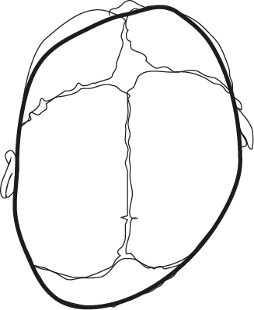
Ipsilateral frontal bossing
Ipsilateral ear displaced anteriorly
Contralateral occipital bossing
Ipsilateral occipitoparietal flattening
Kabbani et al.Am Fam Physician. 2004 Jun 15;69(12):2863-2870.

Slide 27
Trigonocephaly
Derived from the Greek word trigonos, meaning triangular
Metopic synostosis.
5 → 10% incidence

Slide 28
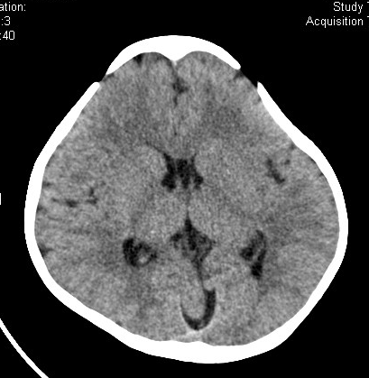
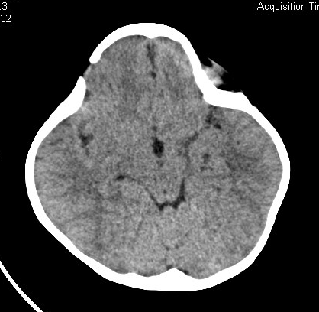
Trigonocephaly

Slide 29
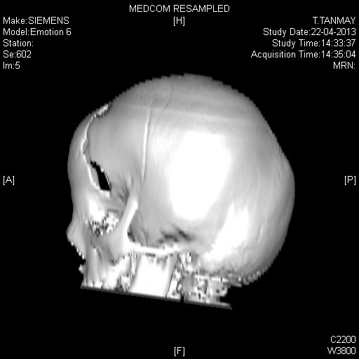
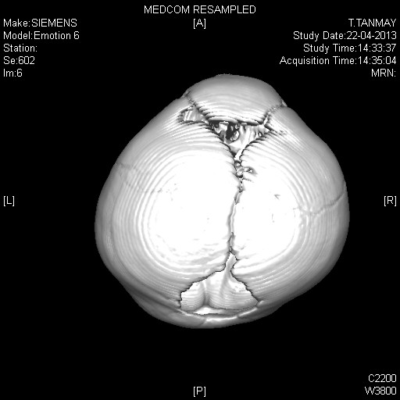
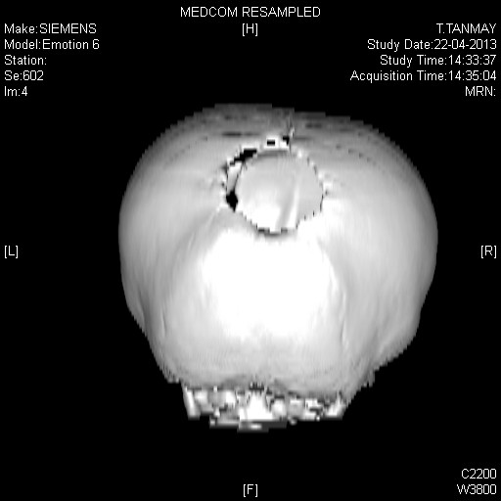
Trigonocephaly

Slide 30
Brachycephaly
Greek word brachys, meaning short.
Both coronal sutures
10-20%

Slide 31
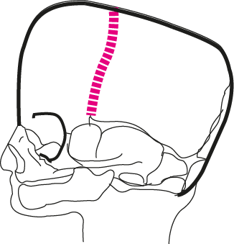
Bilateral coronal synostosis results in a prominent frontal bone, flattened occiput. and anterior displacement of the skull vertex.
Kabbani et al.Am Fam Physician. 2004 Jun 15;69(12):2863-2870.

Slide 32
Oxycephaly
Oxys, meaning sharp, and is a high, conical head with sharp bossing in the region of the anterior fontanelle
Coronal and sagittal sutures
results in an abnormally high conical head shape
Encountered in syndromic types.

Slide 33
Cloverleaf skull deformity (Triphyllocephaly)
(Derived from the Greek word triphyllos, meaning trefoil, with 3 leaves),
Multiple suture synostosis
Head shaped like a cloverleaf
Three bulges-two temporal and top
Pronounced constrictions in both sylvian fissures

Slide 34
Frequency
Sagittal→ 45%-50%
Unilateral coronal →15%
Metopic synostosis→ 5%
Lambdoid→1.3%

Slide 35
CRANIOSYNOSTOSIS
SYNDROMES
10-20 % of cases
Autosomal Dominant
  Linked to Chromosome 10
  Multi-sutural, complex case
If a suture is fused, check hands, feet, big toe and thumb

Slide 36
Crouzon’s
Autosomal - dominant pattern.
One of every 25,000 live births
5 percent of cases of craniosynostosis.
Corde Mason A, Bentz ML, Losken W. Craniofacial syndromes. In: Zitelli BJ, Davis HW, eds. Atlas of pediatric physical diagnosis. 4th ed. St. Louis: Mosby, 2002:803-17.

Slide 37
Clinical findings
Brachycephaly,
Significant hypertelorism, proptosis, maxillary
hypoplasia, beaked nose
Intracranial anomalies
Hydrocephalus, Chiari 1 malformation, and
hindbrain herniation (70 percent).

Slide 38
Normal intellect
Normal extremities
5 % have Acanthosis nigricans
30 % have progressive hydrocephalus

Slide 39
Apert’s -“Crouzon’s with Hand Involvement”
1 in 55,000
Varying intellect (50 % with MR)
Syndactyly
Cervical vertebral anomalies
Rare hydrocephalus

Slide 40
PFEIFFER SYNDROME
1 in 2 lakhs
Clover leaf skull in 20%
Broad thumbs, broad great toes
Intelligence is reported to be normal

Slide 41
CARPENTER SYNDROME
Autosomal recessive.
Syndactyly of feet
Sagittal and lambdoid suture closes first coronal last
Cardiac abnormalities

Slide 42
Diagnosis
Clinical history
Physical examination
Radiographic studies

Slide 43
Passage of the head through the birth canal deforms the head. This shape is retained for 2-3 weeks postnatally.
Early diagnosis is important
The brain grows rapidly during this period
Delay only worsens the deformity of the head shape.

Slide 44
Detailed history
Birth, sleeping position.
Head tilt, torticollis
deformational plagiocephaly
Family history
Abnormal head shape or multiple systemic problems (eg,cardiac, genitourinary, musculoskeletal)

Slide 45
Clinical Exam
Head shape (from above, side)
Ear and facial symmetry
Palpate suture lines & fontanelles
Look for ridging
Look for associated anomalies
If a suture is fused,
check hands, feet, big toe and thumb

Slide 46
FUNCTIONAL CONSEQUENCES
Intra cranial hypertension
Complicates one third of cases
Principal indication of surgery
ICP monitoring
Syndromic forms →30%
17% single suture
Causes Abnormal venous drainage
Respiratory obstruction
Chiari malformations

Slide 47
Hydrocephalous
4% to 18%
Communicating
?causes
Cerebral maldovelopment
Brain atrophy
Abnormal csf circulation
Venous outflow obstruction
Hind brain herniation
Aqueductal stenosis

Slide 48
Respiratory Abnormalities
Syndromic craniosynostosis
Manifest during sleep
Maxillary hypoplasia, choanal stenosis, tonsillar hypertrophy
Nasal stents, tonsillectomy or tracheostomy
Nocturnal CPAP
Surgical correction of midfacial hypoplasia

Slide 49
Feeding
Abnormalities of palatal shape and movement
Disordered dentition
Dental malocclusion
Nasogastric tube or gastrostomy

Slide 50
Vision
Chronically raised ICP-----papilloedema----optic atrophy (Crouzon syndrome)
Shallow orbits ---------exposure
Primary optic atrophy: compression, traction
Early craniectomy

Slide 51
Plain Films
Simple and inexpensive,
Absent or line of increased density
Harlequin appearence→coronal
Cannot differentiate
Lambdoid synostosis and deformational plagiocephaly (plagiocephaly without synostosis).
To visualize all the sutures, special Waters views must be taken.

Slide 52
Ultrasound
Noninvasive
More effective than plain skull radiographs in detecting fused sutures
Accuracy depends on a reliable and experienced operator.

Slide 53
CT Scan
Standard for the complete visualization
of the skull and cranial sutures.
Detailed anatomy of the calvaria and the brain parenchyma
Document effect of corrective surgery

Slide 54
MRI
Complex craniosynostosis
Improved definition of intracranial soft tissue structures
Hindbrain herniation
Identify sites of respiratory obstruction

Slide 55
Radio isotope scanning
Diminished uptake→ complete fusion

Slide 56
ICP monitoring
Clinically occult – Majority
Radiological signs inconclusive
Deciding nature and timing of surgery
Features of ↑ ICT
Mean pressure > 15 mm Hg
Raised base line value
Prolonged plateau wave

Slide 57
Management
Surgery vs. Conservative Management

Slide 58
Goal
Normalization of deviated appearance, growth and function of skull
Keep the suture open till brain growth is complete
Rarely achieved

Slide 59
Indications
Correction of cosmetic abnormality
Early treatment of intracranial hypertension
Optimizing brain growth
Severe proptosis and impending corneal damage

Slide 60
Timing of surgery
Early operation(3-6 months)
Rapid brain growth reshape bone
Better compliance of brain dura and scalp
Calvarium in an infant aged 3-9 months is much more malleable, easier to shape and providing a better outcome.
journal of pediatric neurosciences
REVIEW ARTICLE Year : 2009 | Volume : 4 | Issue : 2 | Page : 86-99 Pediatric craniofacial surgery for craniosynostosis: YN Anantheswar¹, NK Venkataramana²
¹ Department of Plastic Surgery, Manipal Hospital, Kengeri, Bangalore, India
² Advanced Neuroscience Institute, BGS Global Hospital, Kengeri, Bangalore, India

Slide 61
Prefers operating within 3-6monts time frame to take advantage of the ability of the rapidly expanding brain and skull to grow more normally and so that the skull can be remodeled more readily.
Management Considerations in the Treatment of Craniosynostosis John A. Persing, M.D.New Haven, Conn.Plastic and Reconstructive Surgery • April 2008
Surgical intervention should be performed during infancy, preferably in the first 6 months of postnatal life, to prevent the further progression of the deformity and possible complications associated with increased intracranial pressure.
Plast Reconstr Surg. 2003 May;111(6):2032-48; quiz 2049.Management of craniosynostosis.Panchal J, Uttchin V.Oklahoma University Health Science Center, Oklahoma

Slide 62
Early frontocranial remodelling is performed between 2 and 4 months for brachycephalies
Other operated on between 6 and 12 months of age.
For syndromal craniofacial synostosis, two-step operation: forehead advancement first
Facial advancement later, to avoid the risk of frontal osteitis
Br J Plast Surg. 1994 Jun;47(4):211-22.
Timing of treatment for craniosynostosis and facio-craniosynostosis: a 20-year experience.Marchac D, Renier D, Broumand S.Craniofacial Unit, Hôpital Necker-Enfants Malades, Paris, France

Slide 63
Late intervention
Closer the cranium is to the adult size, the less overcorrection for reconstruction and the better the ultimate skull shape.
Higher risk of recurrent deformity
Surgical correction more complex

Slide 64
Basic mechanisms
Passive reshapement
Generous removal of bone
Strip craniectomy
Morcellation
Active reshapement
Fronto orbital advancement
Cranial vault reshapement

Slide 65
Incision
Zigzag bicoronal incision
Prevents parting of the hair along a straight line
Scar tends to spread less - redistribution of the forces.
Incision begins slightly anterior and superior to the helix of the ear.
Electrocautery is used cautiously

Slide 66
Sagittal craniosynostosis
Objectives
  Correction of scaphocephaly
  Frontal bossing and occipital protrusion
Initial surgical procedures included a narrow-strip craniectomy→ higher restenosis .
Wider and more extensive craniectomy
Do not address the frontal bossing and occipital bathrocephaly relied on the growing brain to correct these deformities.

Slide 67
More extensive cranial vault remodeling with barrel-stave osteotomy
Spring assisted cranioplasty
With the advent of endoscopes in neurosurgery, extended-strip craniectomy is performed and the patient is placed in a custom-made molding helmet to correct the frontal bossing and bathrocephaly.
Rapid recovery of the child and diminished need for blood transfusion,

Slide 68
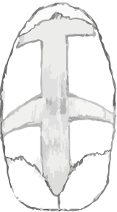
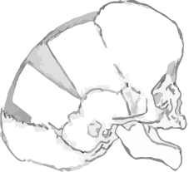
Posterior
Anterior

Slide 69
Bilateral coronal stenosis
Extended bicoronal craniectomies with reconstruction of the forehead.
The supraorbital bar or brow is reshaped and advanced forward with the forehead.
The reconstructed forehead and brow are rigidly fixed to the nose and lateral orbits with microplates.

Slide 70
Metopic stenosis
Objectives increase in width of the bifrontal diameter, an increase in volume of the anterior cranial fossa,and normalization of frontal bone shape.
The frontal bones and the frontoorbital bones are excised and transferred to the side assembly
The frontoorbital bar is advanced to create an appropriate brow position.
The interdacryon distance is increased by placing a bone graft between the 2 halves of the frontoorbital bars.

Slide 71
Syndromic craniosynostosis
Current surgical treatment approach
Initial fronto-orbital and cranial vault remodeling,
A midface advancement procedure with or without distraction (Le Fort III or monobloc)
Secondary orthognathic surgery
To correct any dentofacial deformities (Le Fort I, mandibular osteotomies)

Slide 72
Conservative Therapy for Deformational Plagiocephaly
Re-positioning
If no improvement
by 6 months….
  Helmet Molding

Slide 73
Long Term Follow-Up
Speech
Genetic Counseling
Feeding / Swallowing
Ophtho

Slide 74
Thank you

